Slide 1
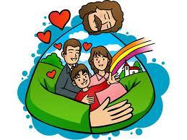
The True Family Members of Jesus Mark 3:20-35
Ki Tam
Preached for Dr. Rick Griffith, Singapore Bible College www.biblestudydownloads.com

Slide 2
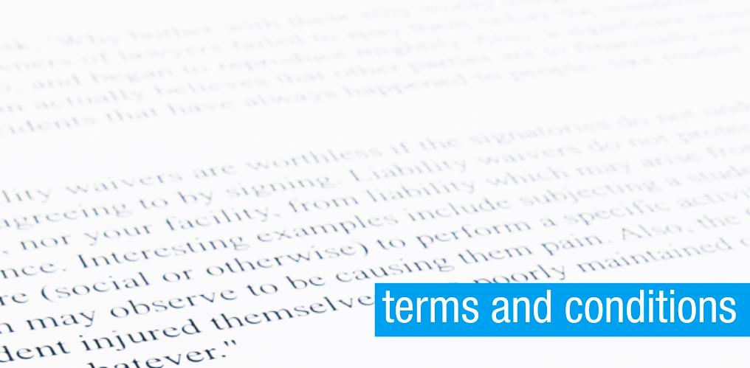
Terms and conditions are always predetermined by the company or the organization.
Jesus set the terms and conditions for those who want to be His family members.

Slide 3
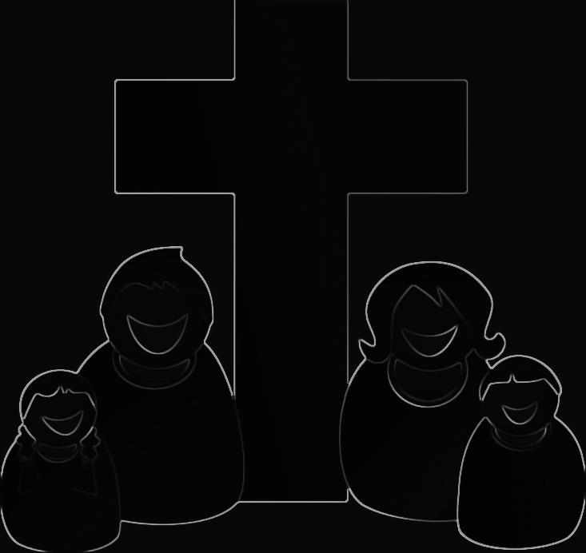
Jesus asked, “Who are my mother and brothers?”
“How can we be sure of our relationship with Jesus?”
“What are the terms and conditions to be members of Jesus’ family?
Who are the true family members of Jesus?

Slide 4
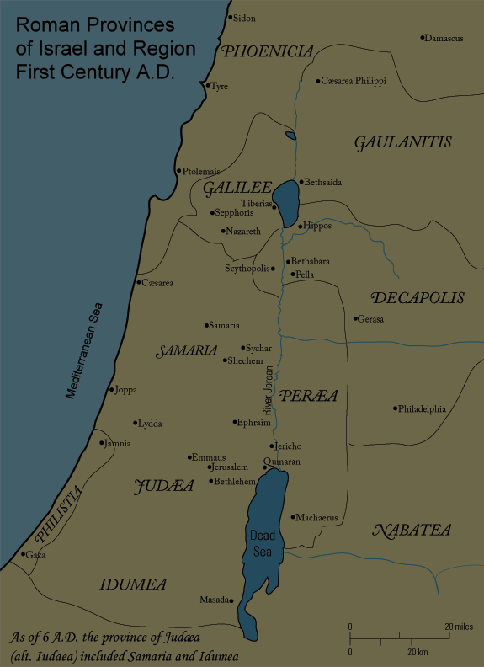
12 Disciples
Faithful Followers
Jesus Preaching
Jesus’ Family
Scribes

Slide 5
I. Christ’s true family members follow him (3:20-21)
A. They listen and believe the works and words of Jesus even as new believers (20).
B. False followers do not believe in Jesus though they may be born into a Christian family (21).

Slide 6
II. Satan can destroy Christ’s family if he can defeat Christ (22-30).
A. A true family stays strong by not attacking their fellow believers (22-26).
B. The only way Satan can destroy Christ's spiritual family is by defeating Christ as defender of the family (27-30).

Slide 7
III. Believers can be sure that they belong to Christ’s family (31-33).
A. Only true believers will enjoy the privilege to be Christ's family members (31-32).
B. True believers will do the will of the Father which is believing in Jesus and His teachings (33-35).

Slide 8
Conclusion
1. We are not Christ’s family members on our own terms and conditions.
2. Today it is still challenging to believe and follow Jesus as it seems foolish in the eyes of others. True family members of Christ will always believe and follow Him though it may seem to be foolish thing to do.
3. What challenges do you face from believing and following Jesus all the way?

Slide 9
Black

Slide 10
NT Sermons link at biblestudydownloads.com
Get this presentation and script for free!

